Slide 1
Infrastructure Testing with Pester
>_
#!
Presented by:
Adam the Automator

Slide 2

PS> whoami
Training Course Author
PowerShell Trainer
Freelance Writer
PowerShell Consultant
Blog: adamtheautomator.com
Twitter: @adbertram
Microsoft Content/ Datacenter Management MVP

Slide 3
What to Expect
1
2
3
NOT A TALK ON PESTER HOW-TO
INFRASTRUCTURE TEST THINKING & MENTALITY
FOCUS ON IMPLEMENTING DESIGNS WITH CODE

Slide 4
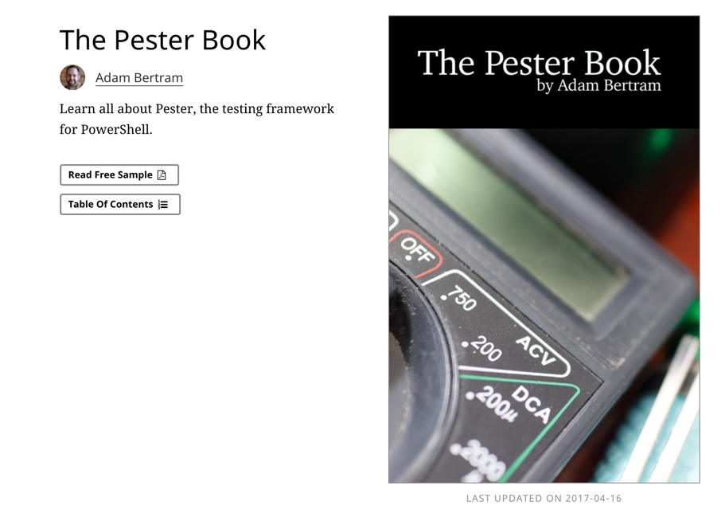
The Pester Book
https://leanpub.com/pesterbook

Slide 5
What is Infrastructure Testing?
DEFINE AN EXPECTED ENVIRONMENTAL STATE
RUN CODE TO RETRIEVE THE ACTUAL STATE
COMPARE
THE TWO
NOT UNIT
TESTING

Slide 6
The Benefits
Understand your code's entire lifecycle
Increased trust
A definition of "working"
Reliable deployments

Slide 7
A Tool for Many Purposes
1
2
Testing general changes
Testing the result of code

Slide 8
Infrastructure Testing in the Real World: Components
API Gateway
Dozens of APIs
SQL database
Multiple SQL firewall rules
Azure web app
Azure app service plan
Azure operational insights instance
Web app source files uploaded
XSD schemas upload to specific folder

Slide 9
Infrastructure Testing in the Real World: “Testing”
“I did that thing.
It doesn't return an error and looks good in the Portal.
Check it out.”
“Looks good but you forgot this other thing.”
“I've got this thing.”
“Adam,
do that thing.”
DEVELOPER
MANAGER
ME
DEVELOPER
REPEAT AD INFINITUM

Slide 10
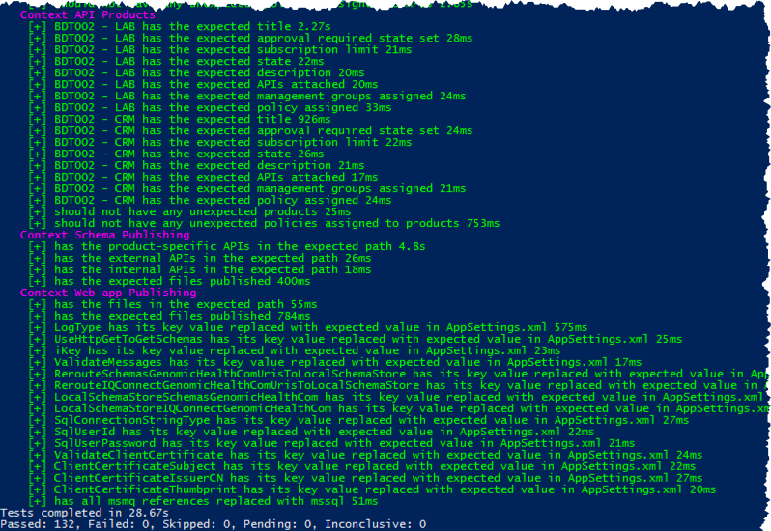
Infrastructure Testing in the Real World: Testing

Slide 11
Infrastructure Testing in the Real World: Testing is Awesome
1
2
3
REPEATABLE
AUTOMATABLE
RELIABLE

Slide 12
Demo: Infrastructure Testing 101
Create AD user somehow
Create Get-AdUser code
Compare with Pester

Slide 13
Demo: Provisioning a New Domain
Build the DSC configuration
Apply the DSC configuration
Test the DSC configuration
Remove everything (optional)

Slide 14
Step 1: Defining Expected Behavior
Define configuration data outside of functional code
Reuse for your tests

Slide 15
Step 2: Dealing with Dependencies
1
2
Must be accounted for
Define dependency failure actions

Slide 16
Step 3: Creating Pester Tests
Building the test framework
Inserting the “dependency code”
Inserting the “read code”

Slide 17
Questions Demo Resources
bit.ly/infratesting

